Slide 1


DESIGN 1
Lesson 4: Formative Assessment: HTML Structure & Text Formatting
Ms. Abboud • Grade 9 - Design 1 • Term 1, Week 3

Slide 2
Learning Objectives
WALT - We Are Learning To
WILF - What I'm Looking For
Demonstrate correct HTML document structure (Weeks 1-2) together with this week's text formatting.
Complete the Week 3 formative assessment independently.
Valid HTML structure carried over from Weeks 1-2 - correct DOCTYPE/html/head/body, no broken nesting.
Text formatting tags used correctly, with content organized logically and readably.

Slide 3
Frayer Model: Nesting (Review)
DEFINITION
CHARACTERISTICS
Placing one HTML element inside another, so the inner element is fully contained within the outer one.
One element fully inside another; inner tags close before outer tags.
NESTING
EXAMPLES
NON-EXAMPLES
<li> inside <ul>; <strong> inside <p>.
Two tags placed side-by-side, not inside one another.

Slide 4
National Identity Integration
Effective Digital Communication: this assessment reflects the same standard used in real UAE digital services - a page that is both structurally valid and clearly formatted, so every reader can trust and use it.

Slide 5
STARTER
Tag Review Game
Flash a tag on the screen, say its purpose out loud.
Mixes structure tags (html, head, body) with this week's tags (h1, p, strong, em).
Hook • Engage & Ask
5 - 10 minutes

Slide 6
LESSON CORE
I Do: Task & Rubric
Rubric shared in advance, per the Academic Integrity & Assessment Policy.
Checks both this week's text formatting and Weeks 1-2 document structure.
Gradual Release of Responsibility
30 - 40 minutes
1 / 2

Slide 7
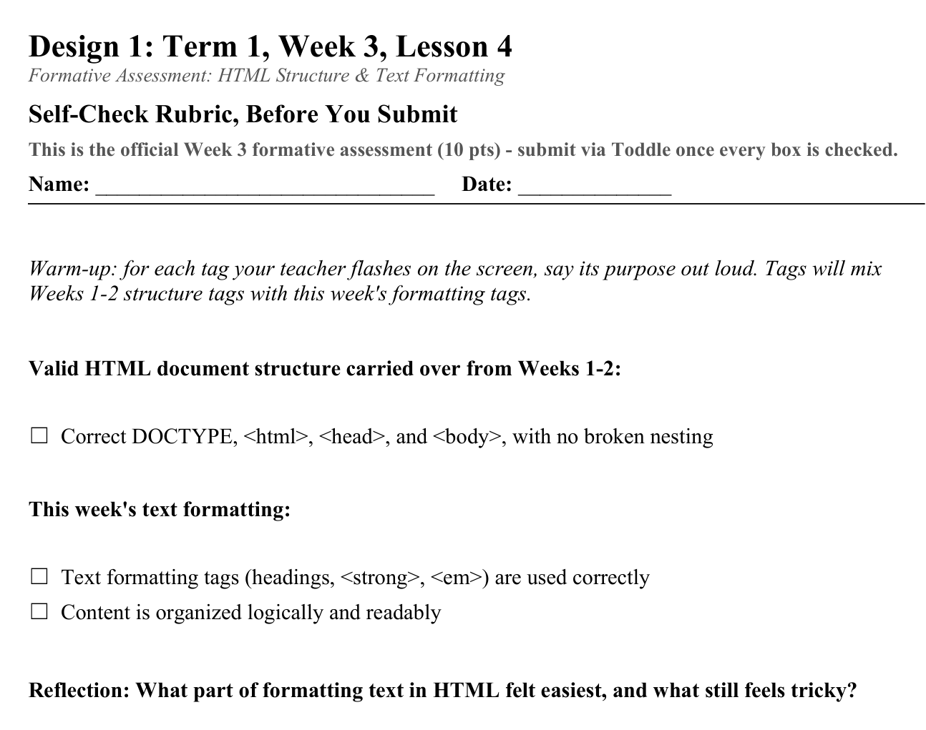
LESSON CORE
You Do: Formative Assessment (10 pts)
Build or extend a webpage section with valid HTML structure AND correct headings, paragraphs, and text formatting.
Self-check against the rubric before submitting via Toddle.
Activity: Self-Check Rubric, Before You Submit
Gradual Release of Responsibility
30 - 40 minutes
2 / 2

Slide 8
CLOSURE
Reflection
One sentence: what part of formatting text in HTML felt easiest, and what still feels tricky?
Transition & Extend
5 - 10 minutes

